Slide 1
Final Project Mansukh (Mani) Ahuja 301088338 msa103@sfu.ca Mohammad Ahmad 301137468 ahmada@sfu.ca
Assignment 4

Slide 2
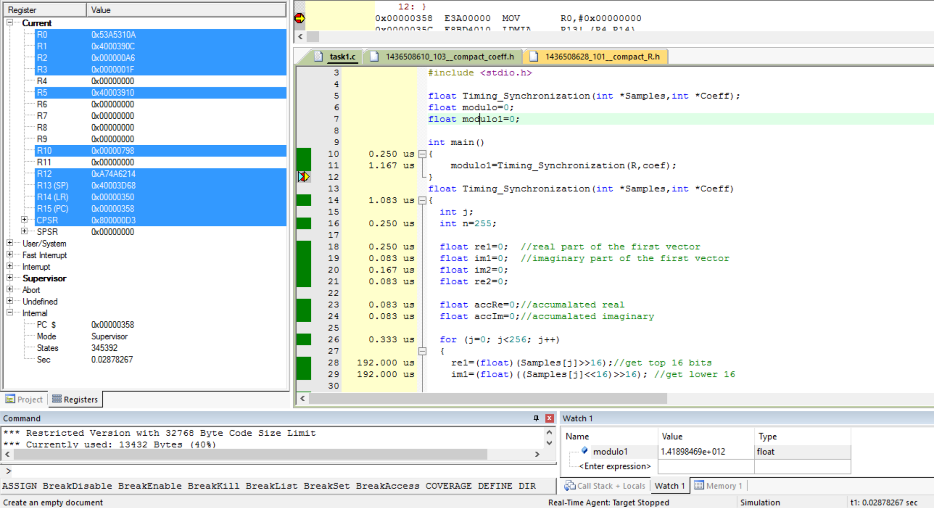
Task 1
The program size if 13432 Bytes
The computation time is .02878267 Seconds

Slide 3
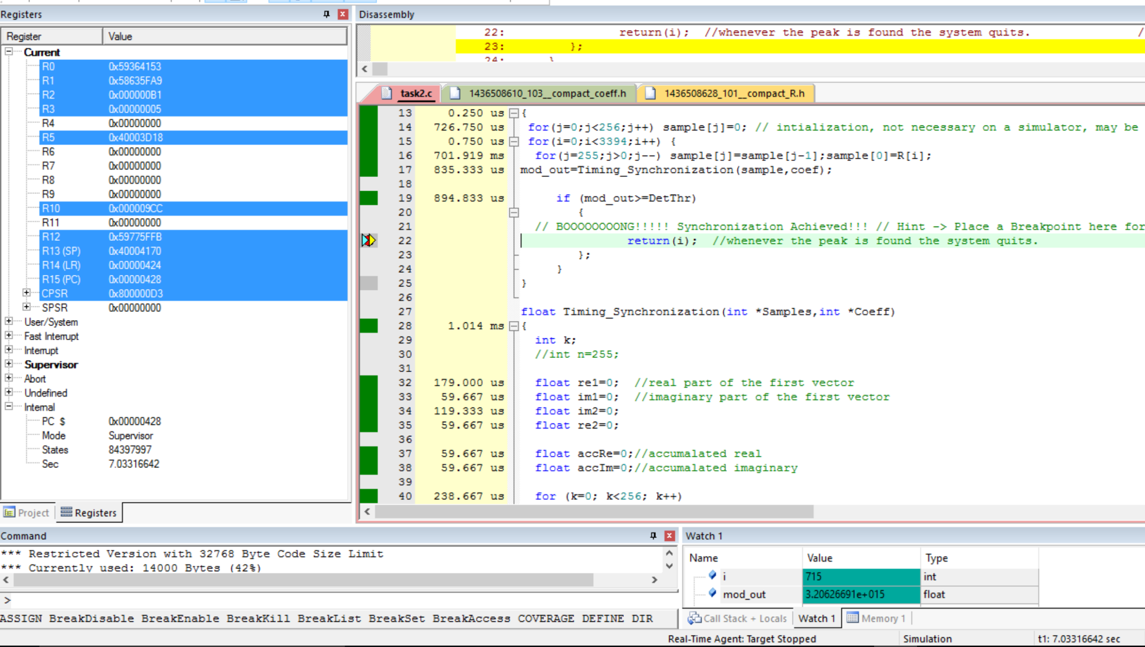
Task 2
There was no simulation error for LPC2104
The threshold is overcome at i=715
Total computation time is 7.03316642 seconds
The program size is 14000 Bytes

Slide 4

Task 3
The threshold is still at I = 715
The computation time is 1.29317592 seconds
The Program size is 12528 Bytes

Slide 5
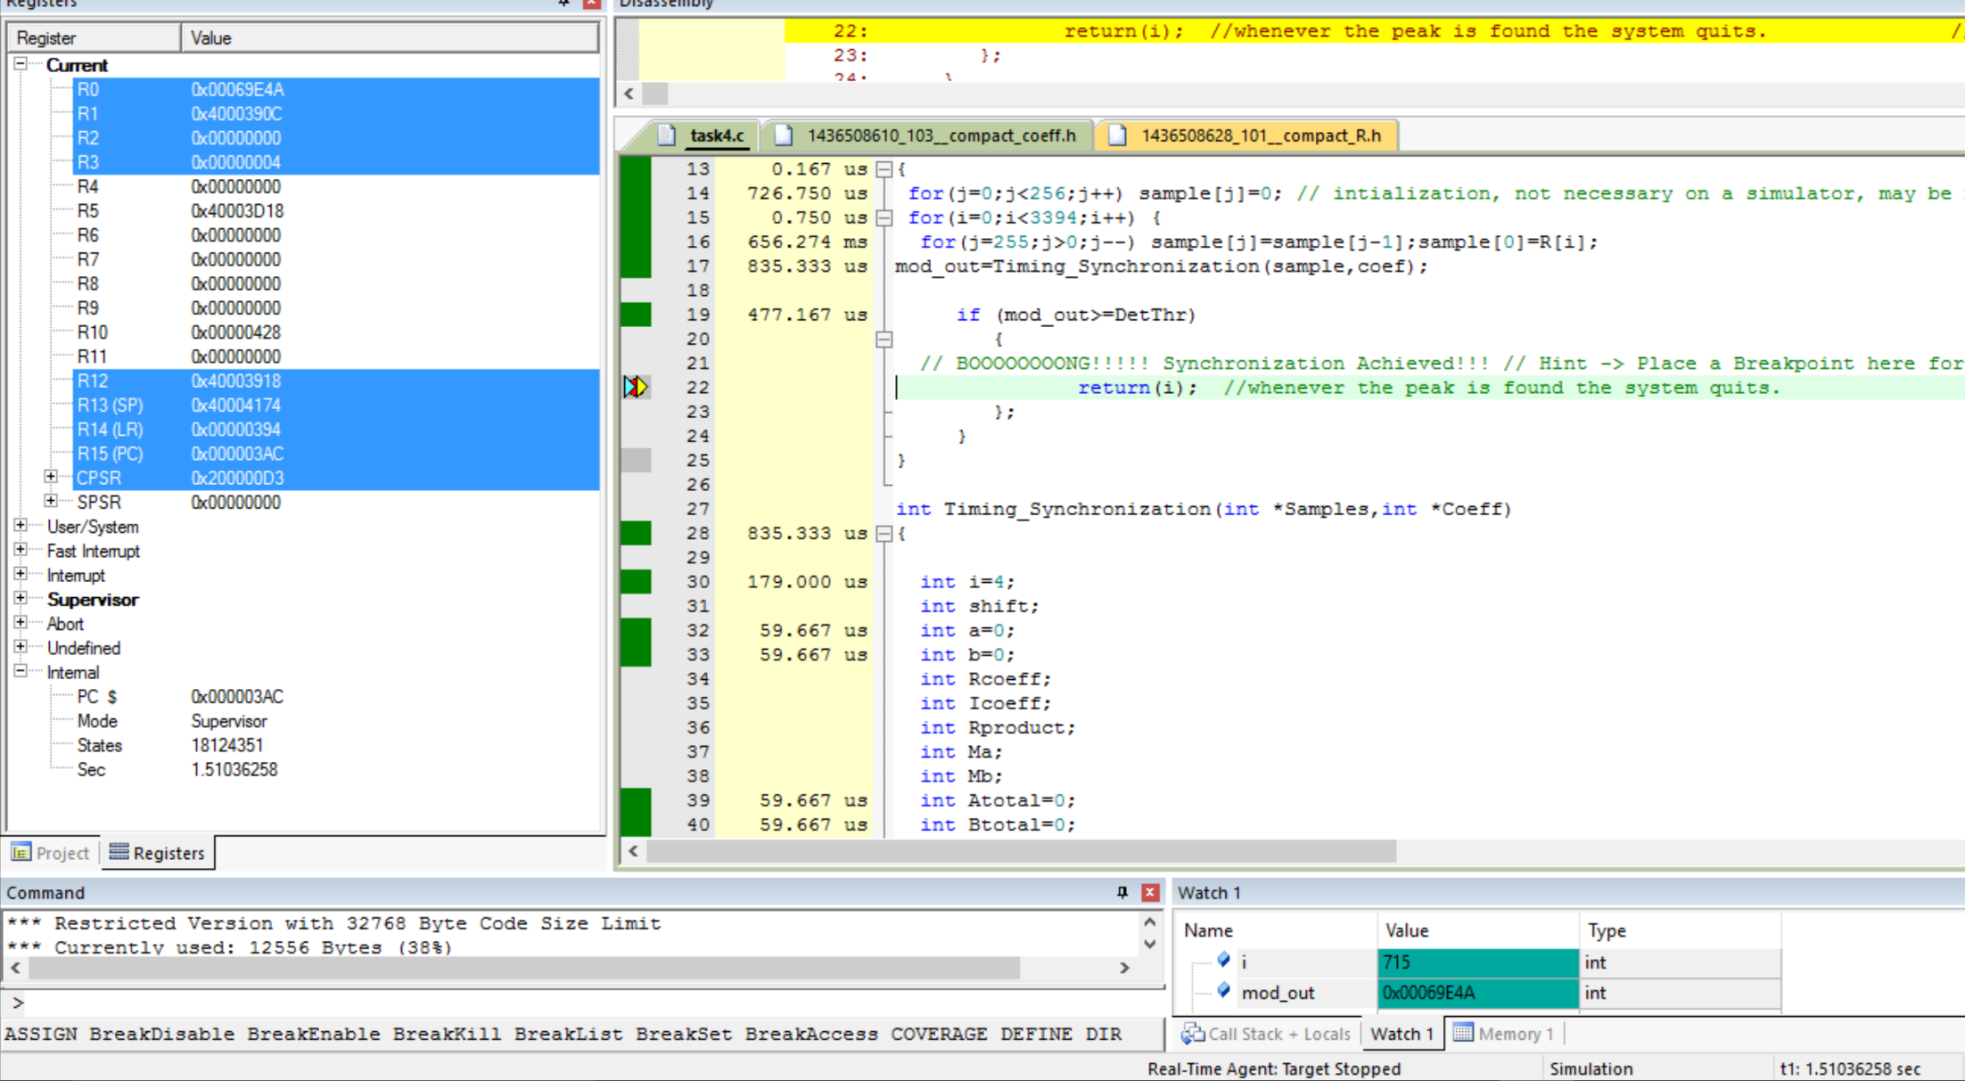
Task 4
The computation time is 1.51036258 Seconds
The Program size is 12556 Bytes

Slide 6
Task 5, 6

